Slide 1
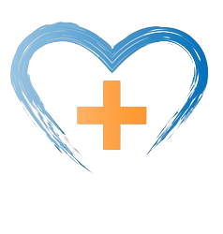
CSC3A MINI PROJECT
PRESENTATION

Slide 2
Structure
1. Introduction
2. Problem
3. High level solution
4. Block
5. Transaction
6. Implementation
7. Conclusion

Slide 3
Introduction
Blockchain

Slide 4
What is BlockCHAIN

Slide 5
BlockChain
Blockchain is a decentralized, digital ledger that records transactions across multiple computers in a way that makes them secure and immutable. It's like a shared database that everyone can trust without needing a central authority.
Blockchain provides transparency through a public record of transactions, enhancing trust and accountability. Its decentralized nature ensures resilience against attacks and disruptions, revolutionizing sectors beyond finance, including governance and supply chain management.

Slide 6
Problem
In rural areas, I've noticed that diabetes and cardiovascular risks aren't adequately managed, leading to complications that strain healthcare systems. Shockingly, South Africa's adult diabetes prevalence has risen to 11.3% from 9.0% in 2015, underlining the pressing need for action. Across Sub-Saharan Africa, insufficient control of these conditions worsens healthcare challenges, resulting in increased morbidity and mortality rates.

Slide 7
High level solution
To tackle this issue, I implemented a blockchain-based healthcare platform. With this platform, we can securely store patient health data, including medical history, treatment plans, and diagnostic results, on a decentralized ledger. Using smart contracts, we can automate various processes such as appointment scheduling, medication reminders, and data sharing between healthcare providers. Patients retain control over their data, allowing them to grant access to authorized providers while ensuring privacy and security. This system enables real-time monitoring and intervention, improving treatment adherence and facilitating timely adjustments to care plans. Moreover, transparent and immutable health records foster seamless communication among healthcare professionals, enhancing collaboration and ultimately improving patient outcomes.

Slide 8
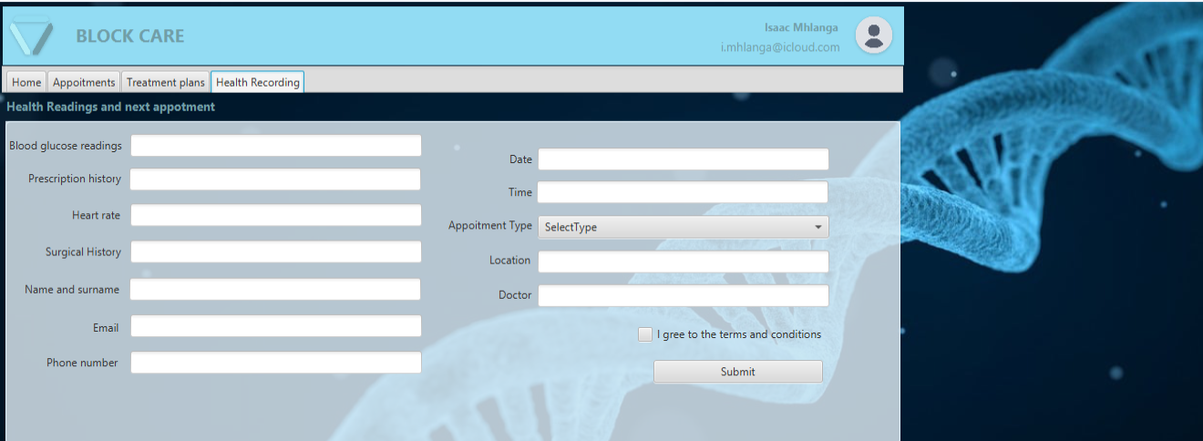
demonstration

Slide 9
Demonstrations Continues
In the previous slide, we introduced a patient form for entering current healthcare information and scheduling appointments. This data is then securely recorded on the blockchain, ensuring integrity and immutability. By leveraging blockchain, we create a transparent record of each patient's health journey, facilitating communication and collaboration among healthcare providers.

Slide 10
Block
The block in this blockchain-based healthcare platform is a container that holds a collection of transactions related to patient healthcare data and interactions within the system. It serves as a unit of data on the blockchain, containing a batch of transactions that are grouped together and added to the blockchain in a sequential and immutable manner. Each block contains a cryptographic hash of the previous block, forming a chain that ensures the integrity and security of the data stored on the blockchain.

Slide 11
Transaction
A transaction in this context refers to a specific action or event related to patient healthcare data or platform interactions. These transactions include activities such as patient registration, appointment scheduling, medical records updates, medication reminders, and data sharing permissions. Each transaction represents a discrete piece of information recorded on the blockchain, providing a transparent and auditable record of patient interactions and healthcare data within the system. Transactions are bundled together into blocks and added to the blockchain, forming an immutable ledger of patient healthcare activities.

Slide 12
Implementation
Having integrated the blockchain classes into our project, we've meticulously designed user interfaces for patient interactions using Scene Builder. These interfaces cater to various functionalities, from patient registration to appointment scheduling, medical records updates, medication reminders, and data sharing permissions.
In terms of backend logic, we've implemented comprehensive code to seamlessly handle user inputs, process transactions, and interact with the blockchain data structure. Smart contracts have been leveraged to automate key processes like appointment scheduling and medication reminders, thus streamlining patient care management.

Slide 13
Implementation continues
Real-time monitoring capabilities have been incorporated, empowering healthcare providers to promptly access and analyze patient data. This enables timely adjustments to care plans and interventions, ultimately improving patient outcomes. Moreover, stringent privacy and security measures ensure compliance with healthcare regulations and standards, with patient data securely stored on the decentralized ledger.

Slide 14
Conclusion

Slide 15
To wrap up, my proposal lays out a solid plan to boost diabetes care in remote healthcare setups using blockchain technology. The aim is simple: to make sure patients get better and lighten the load for healthcare providers by fixing the kinks in our current systems. With some smart algorithms and data structures, I believe we can really shake things up in diabetes care, even in places with limited resources. It's all about putting our heads together, thinking outside the box, and making a positive difference in people's lives.

